Slide 1


Data Since Project Berlin Ratings
by Ilya Zutler
2024
Tel-Aviv, Israel

Slide 2
Structure of Project
1
The Goal of the project is to investigate apartments rented in Berlin via Airbnb and the relationship between: apartment details, polarity of comments and ratings with the rental price in data frame:
https://www.kaggle.com/datasets/thedevastator/berlin-airbnb-ratings-how-hosts-measure-up
The project includes the following stages:
Data Preparation
Exploratory Data Analysis
Data Cleaning & Outliers
Feature Engineering & Data Transformation
Model Selection and Feature Selection
Fine Tuning with Cross-Validation

Slide 3
Data Preparation
2
The data frame contains information about apartments rented in Berlin via Airbnb and guests' comments about them.
The data frame has 457k rows. Rows contain:
Comment of one guest
Apartment details (location, number of rooms, etc.)
Rental Price
Apartment rating (average for all reviews)
The apartment data is repeated in rows many times.
457k
Notes:
The original data frame takes up 250 MB.
Therefore, the data frame is divided into two tables:
Comments of guests (with apartment ID)
Apartment data (once for one apartment).
The tables take up 37 MB and 3.5 MB respectively.

Slide 4
Data Preparation
1
The data frame contains information about apartments rented in Berlin via Airbnb and guests' comments about them.
The data frame has 457k rows. Rows contain:
Comment of one guest
Apartment details (location, number of rooms, etc.)
Rental Price
Apartment rating (average for all reviews)
The apartment data is repeated in rows many times.
The data frame contains data about 23.5k unique apartments, of which 4.1k apartments have no comments and ratings.
457k
23.5k
(4.1k have no Comm and Rating)
Notes:
The original data frame takes up 250 MB.
Therefore, the data frame is divided into two tables:
Comments of guests (with apartment ID)
Apartment data (once for one apartment).
The tables take up 37 MB and 3.5 MB respectively.

Slide 5
Data Preparation
2
The data frame contains information about apartments rented in Berlin via Airbnb and guests' comments about them.
The data frame has 457k rows. Rows contain:
Comment of one guest
Apartment details (location, number of rooms, etc.)
Rental Price
Apartment rating (average for all reviews)
The apartment data is repeated in rows many times.
The data frame contains data about 23.5k unique apartments, of which 4.1k apartments have no comments and ratings.
The Polarity of comments was analyzed using TextBlob and translation from different languages.
457k
23.5k
(4.1k have no Comm and Rating)
added Polatity using TextBlob
Notes:
The original data frame takes up 250 MB.
Therefore, the data frame is divided into two tables:
Comments of guests (with apartment ID)
Apartment data (once for one apartment).
The tables take up 37 MB and 3.5 MB respectively.

Slide 6
Data Preparation
2
The data frame contains information about apartments rented in Berlin via Airbnb and guests' comments about them.
The data frame has 457k rows. Rows contain:
Comment of one guest
Apartment details (location, number of rooms, etc.)
Rental Price
Apartment rating (average for all reviews)
The apartment data is repeated in rows many times.
The data frame contains data about 23.5k unique apartments, of which 4.1k apartments have no comments and ratings.
The Polarity of comments was analyzed using TextBlob and translation from different languages.
Aggregated data on the Polarity of comments for each apartment were added to the Apartments table (min, max, mean, median polarity) .
The resulting Apartments table is a flat file for further analysis.
457k
23.5k
(4.1k have no Comm and Rating)
added Polatity using TextBlob
23.5k
(4.1k have no Polarity and Rating)
Notes:
The original data frame takes up 250 MB.
Therefore, the data frame is divided into two tables:
Comments of guests (with apartment ID)
Apartment data (once for one apartment).
The tables take up 37 MB and 3.5 MB respectively.

Slide 7
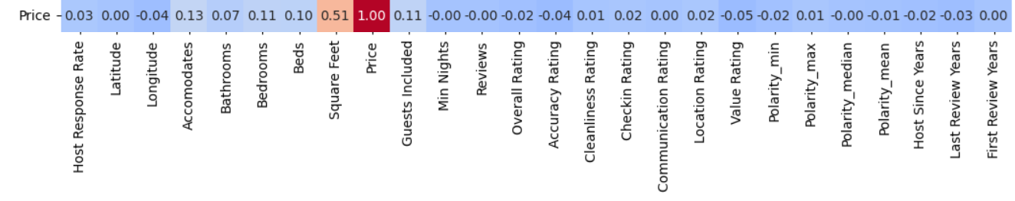
Exploratory Data Analysis
3
Data Protocol, Descriptive Statistics, visualization of Missing data, Numerical and Categorical features , Cross-correlations and Skewness were created. A low correlation was found between numerical data and accommodation price.

Slide 8
Exploratory Data Analysis
3
Data Protocol, Descriptive Statistics, visualization of Missing data, Numerical and Categorical features , Cross-correlations and Skewness were created. A low correlation was found between numerical data and accommodation price.
The ANOVA test showed significant differences in Prices in different Berlin districts: F-value = 12.88, p-value = 0.000.
The significance of paired differences also was clarified using t-test.

Slide 9
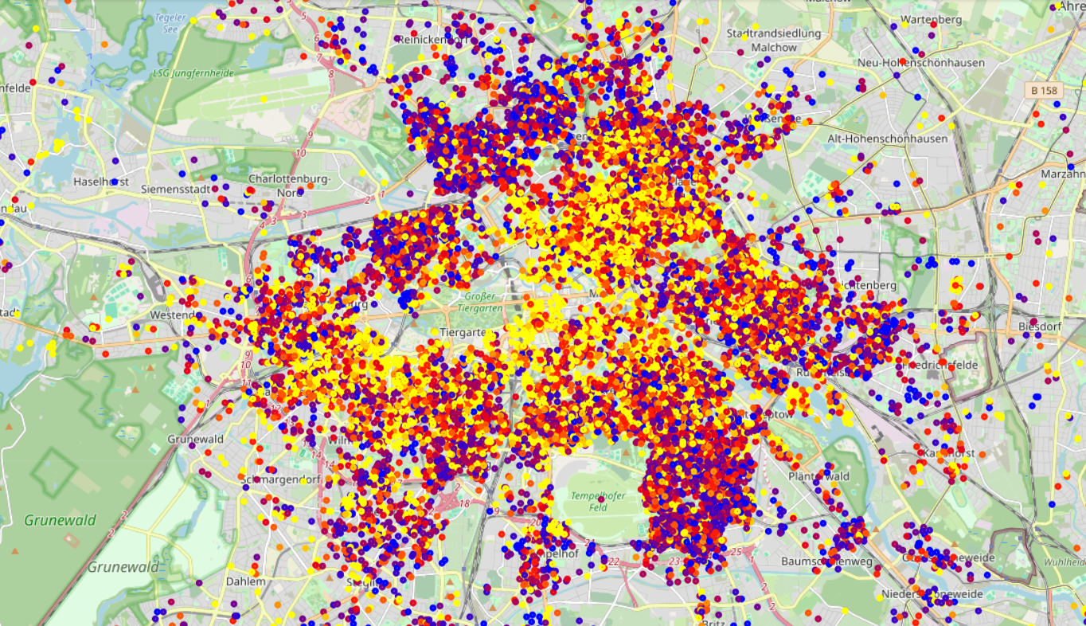
Exploratory Data Analysis
4
This is a map of apartments, colored according to rental price.
We can see some dependence of prices on neighbors' prices.
Spatial Autocorrelation of Price was calculated using Moran’s I
Price Moran’s I : 0.23 p-value = 0.001

Slide 10
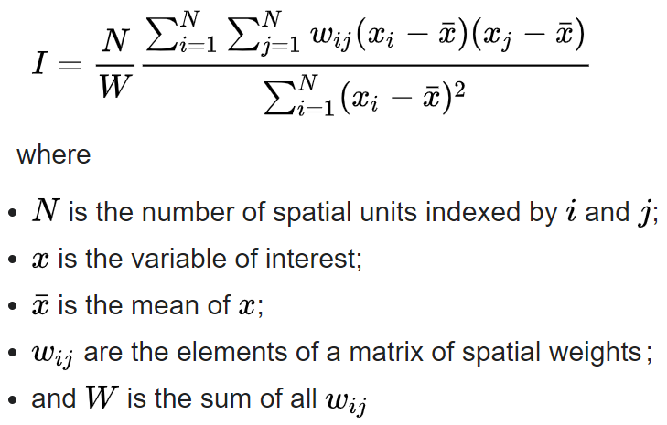
Exploratory Data Analysis
4.1
Spatial Autocorrelation of Price and Location Rating was calculated using Moran’s I
Price Moran’s I : 0.23 p-value = 0.001
Location Rating Moran’s I : 0.22 p-value = 0.001

Slide 11
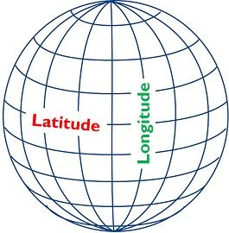
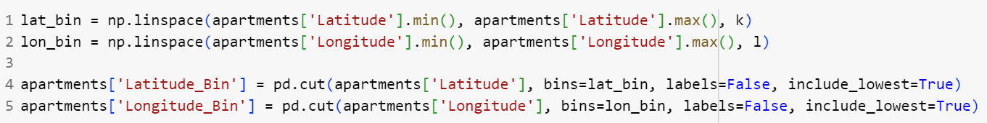
NB Computational complexity
5
To find the closest element to a given one from a set of N elements by simple enumeration, N operations are required. To find the closest element for each element in the set, about N² operations are required.
To reduce the complexity of calculations, it is sometimes possible to divide the set into a grid. How to do it?
For small distances, the angular grid (Latitude-Longitude) can be considered as rectangular (if we are far from the poles, but normally it is) .
This code divides the city into k lanes from north to south and l lanes from east to west.

Slide 12
Data Cleansing & Outliers
6
Missing ‘Post Code’ we fill ​​according to the nearest apartment with a filled Post Code. It is 1-NN model for haversine distance on the Latitude-Longitude. We use grid to do it quickly.
'Bathrooms', 'Bedrooms', 'Beds’, 'Host Since’ we fill the missing values ​​and outliers using MICE imputation.

Slide 13
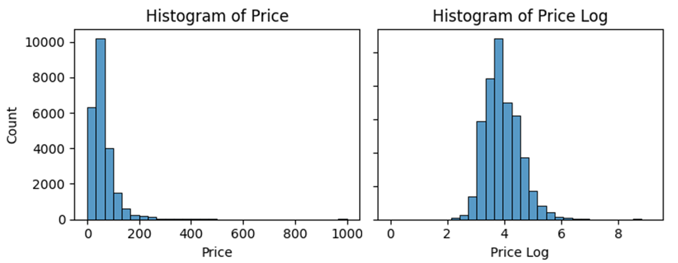
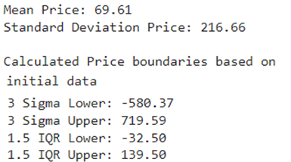
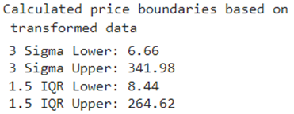
Data Cleansing & Outliers
6
Missing ‘Post Code’ we fill ​​according to the nearest apartment with a filled Post Code. It is 1-NN model for haversine distance on the Latitude-Longitude. We use grid to do it quickly.
'Bathrooms', 'Bedrooms', 'Beds’, 'Host Since’ we fill the missing values ​​and outliers using MICE imputation.
Price’ outliers. Price has a distribution with heavy tails. Log transformation made the distribution more similar to normal.
Here are the outliers boundaries for initial variable and new variable with recalculation them in the original scale.
For the final calculation, I determined the boundaries using more subtle methods. Outliers by 'Price’ - less than 14 and more than 300€.

Slide 14
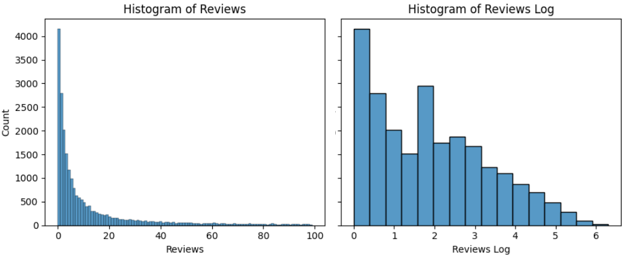
Feature Engineering & Data Transformation
7
The number of Comments takes values ​​in very wide ranges - from 0 to 500 with an average of 19. It can be inconvenient for linear models.
If in the model one comment adds, for example, 0.3 € to the Price, then for some apartments this will immediately add 150 €. Therefor we make Log transformation.

Slide 15
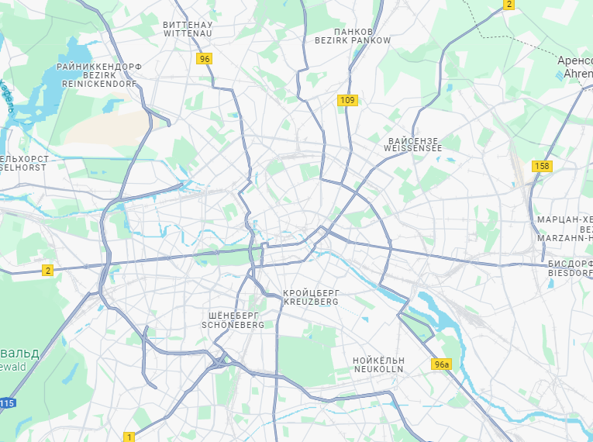
Feature Engineering & Data Transformation
7
The number of Comments takes values ​​in very wide ranges - from 0 to 500 with an average of 19. It can be inconvenient for linear models.
If in the model one comment adds, for example, 0.3 € to the Price, then for some apartments this will immediately add 150 €. Therefor we make Log transformation.
New features are related to the location of apartments.
The city is divided into small squares of 250 x 250 meters and large squares of 500 x 500 meters. Were added new features :
index of the small square in which the apartment is located
index of the large square in which the apartment is located.
A feature has also been added - distance from the city center. It has a small but reliable correlation with the rental price of the apartment.

Slide 16
Model Selection & Feature Selection
8
We tested the following regression models in basic settings:
Lasso, Random Forest, CatBoost, LightGBM, XGBoost
for two types of encoding: One-Hot Encoding and Target Encoding.
(in fact, CatBoost and LightGBM do not require preprocessing of categorical features - they do Target Encoding themselves)
CatBoost and LightGBM are the best out-of-the-box solution, they show good results without manual settings.

Slide 17
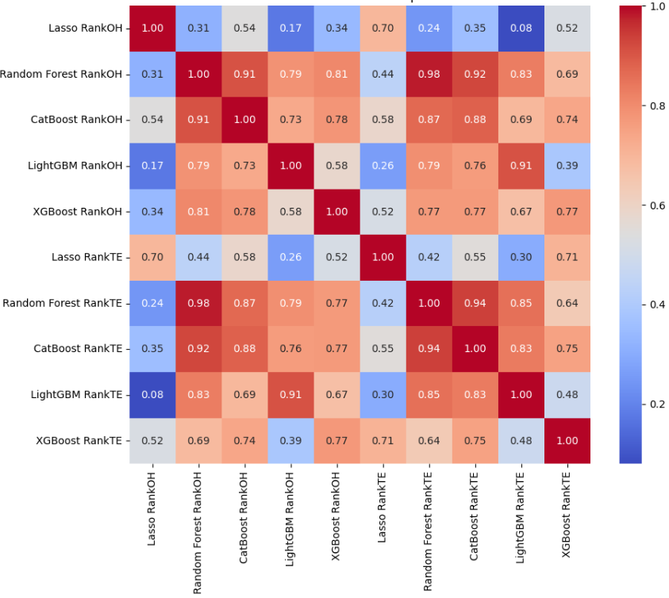
Model Selection & Feature Selection
9
For each model and encoding method, feature importances were ranked (for One-Hot sums of the importances of derived features).
Here is the correlation matrix of feature importance ranks.
It is clear that Lasso ranks features differently from other models that give good results. In this case, Lasso is poorly suited for feature selection.
Lasso is a linear regression model and gives poor results in the case of nonlinear dependencies.

Slide 18
Fine Tuning with Cross-Validation
10
Based on the initial launch of the models, we decided to fine-tune the models CatBoost and XGBoost with Cross-Validation.

Slide 19
Fine Tuning with Cross-Validation
10
Based on the initial launch of the models, we decided to fine-tune the models CatBoost and XGBoost with Cross-Validation.
Features can be divided into three groups: location-related, apartment-related, and hospitality-related.
Our models assigned importance to the features in these groups in completely different ways:

Slide 20

Thank you for your attention

Slide 21
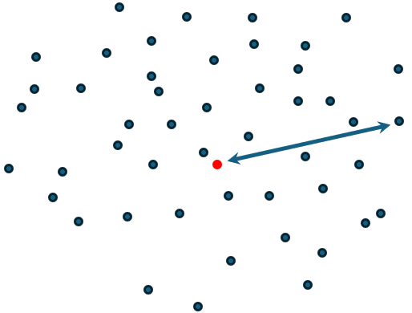
NB Computational complexity
5
To find the closest element to a given one from a set of N elements by simple enumeration, N operations are required.
To find the closest element for each element in the set, about N² operations are required.
And this can be a lot.

Slide 22
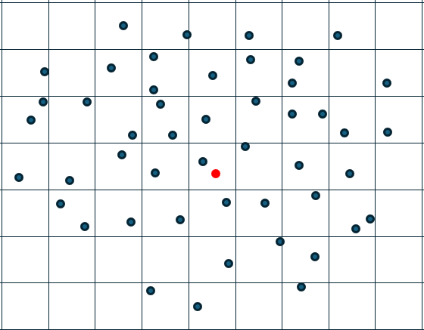
NB Computational complexity
5
To find the closest element to a given one from a set of N elements by simple enumeration, N operations are required.
To find the closest element for each element in the set, about N² operations are required.
And this can be a lot.
To reduce the complexity of calculations, it is sometimes possible to divide the set into a grid. How to do it?

Slide 23
NB Computational complexity
5
For small distances, the angular grid (Latitude-Longitude) can be considered as rectangular (if we are far from the poles, but normally it is)
This code divides the city into k lanes from north to south and l lanes from east to west.

Slide 24
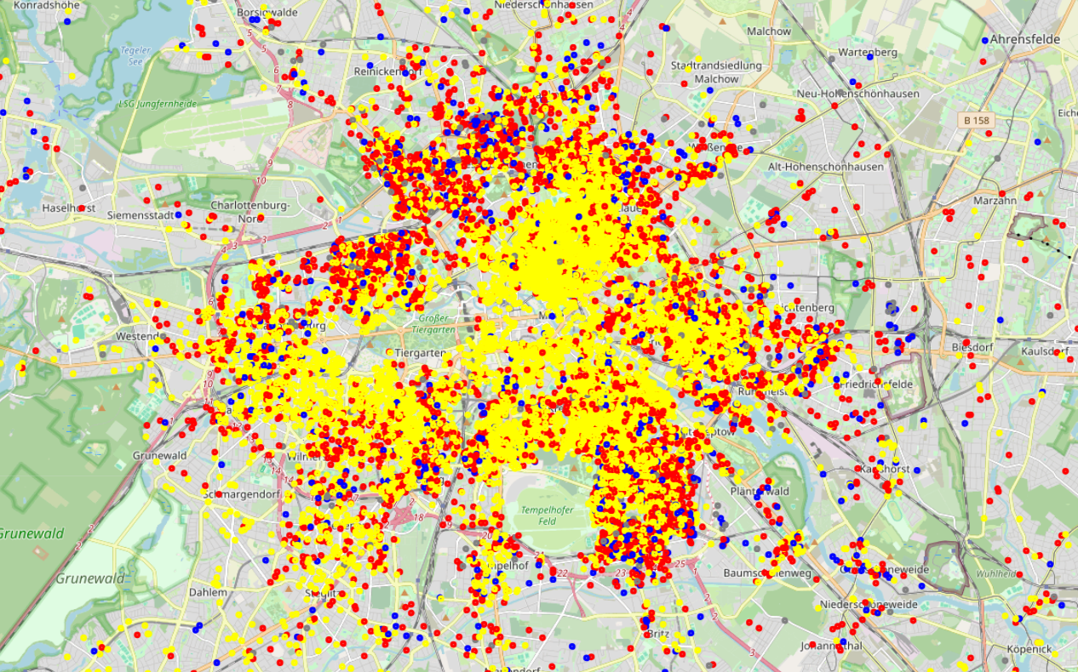
Exploratory Data Analysis
4.1
This is a map of apartments, colored according to Location Rating.

